Slide 1

Capstone Project Fine-tuning of demand & supply of electricity by using forecasting techniques
Team 7
Batch 6A
02nd June 2021

Slide 2
Caveat:
“This document and the data shared are strictly private, confidential to its recipients and should not be copied, distributed or reproduced in whole or in part, nor passed to any third party”

Slide 3
Agenda
1
Objective
Approach
About the dataset
Assumptions
2
3
4

Slide 4



Objective
Revenue optimization strategy by fine tuning demand and supply gap for an electricity distribution company
Power surplus
Demand - Supply
Power deficit

Slide 5
Assumptions
Continuity of data
Data maintains a similar trend across all years under consideration
For any portion of dataset accounting for FY 2020-21, trends to be considered under force majeure only during first half
Supply position
Since the data of sensitive nature, therefore, for supply side scenario availability of power to be considered based on availability from government documents
Available power to be considered on monthly/ yearly basis
Confidentiality
The data is confidential & sensitive in nature and therefore name of the state, company among other details to be kept anonymous
For project purpose, strategy formulation will be on high level to avoid disclosure of any implicit information

Slide 6
Approach
Analyzing the basic metrics
Data exploration & Pre-processing
Data modelling
Strategy for revenue optimization
Performance estimation
Model deployment – demand forecast
Demand-Supply gap analysis
Interpretation of results
Data analysis
Strategy

Slide 7
Approach
Forecasting of Energy demand in terms of Million Units for a year on monthly basis.
Forecasting the future energy demand can play a major role in power purchase decisions of any Distribution Company.
The Energy market in India can be classified as
Long Term market – 12 to 25 Years
Medium Term Market – 5 to 12 Years
Short Term Market- 0-5 Years
Day ahead market facilitated by Power Exchange
Most of the market agreements are bilateral in nature except the Day ahead market which is bidding based.
Forecast of electricity demand on monthly basis can help Distribution companies procure short term power more efficiently, hence reducing the power purchase costs

Slide 8
Source and nature of data
The data for demand was collected from State Load Dispatch Center (SLDC) for the state under consideration (“Confidential) for demand and from monthly installed capacity report published by Central Electricity Authority(CEA) for power availability respectively
The electricity demand is published in the report on monthly/daily basis
For our projections we have used the electricity demand data for a period starting from FY 2015-16 to FY 2020-21 for power consumption and for power availability respectively on monthly basis
Our approach to projections includes forecasting for month on month basis for six months and 12 months respectively

Slide 9
About the dataset (1/2)
This is a sample from a larger dataset of three years for electricity demand for a State in the Indian landscape
The sample dataset captures the electricity demand/consumption for 30 days x 30 intervals which is actually spread across a timeframe of 365 days of a financial year and 96 time intervals on a daily basis
It tabulates electricity demand for each time interval of each day and is measured in Mega Watt (MW)
The actual dataset consists of block wise data for 96 slots for last five years plus the “COVID year” of FY 2020-21

Slide 10

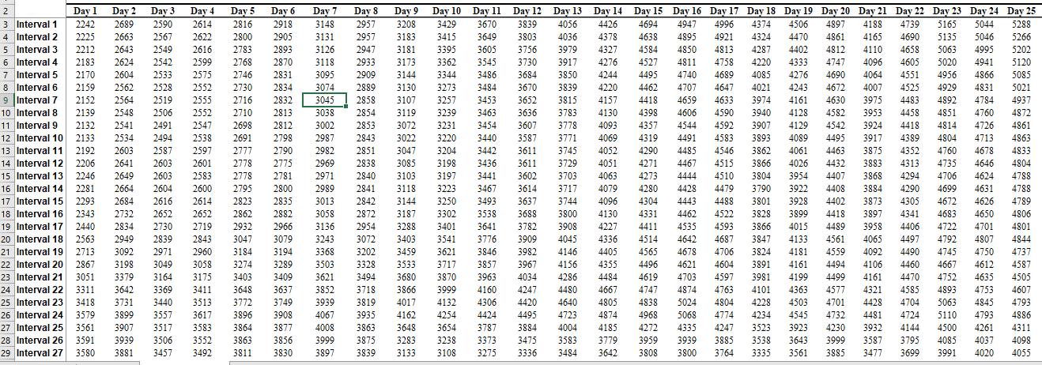
About the dataset (2/2)
Click here

Slide 11
Preliminary analysis
TABC

Slide 12
Preliminary analysis
By the visual inspection of the demand plotted against months we observed following:
There is a trend component and the demand is constantly increasing over the years.
There is also a seasonality component in demand. This is evident from the varying consumption dependent on weather.
There is a cyclicity and irregularity component also.

Slide 13
Selection of forecasting technique
To forecast the demand two techniques were considered
Multiplicative decomposition.
Winter’s Model
The two methods were selected as the date showed trend, seasonality, cyclicity and irregularity component also.
The final projection method was selected which had least Mean Square Error( MSE)

Slide 14
Decomposition technique - multiplicative
On visual inspection we see that the amplitude of the data is increasing.
Hence Multiplicative decomposition is being used.
Also as mentioned before, the data has all the components hence this seems to be most suitable method to forecast.
Identification of components

Slide 15
Decomposition technique – multiplicative/ additive
On visual inspection we see that the amplitude of the data is increasing.
Hence Multiplicative decomposition is being used.
Also as mentioned before, the data has all the components hence this seems to be most suitable method to forecast.

Slide 16


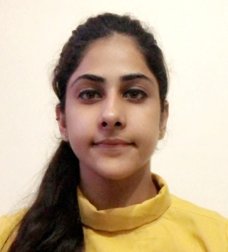
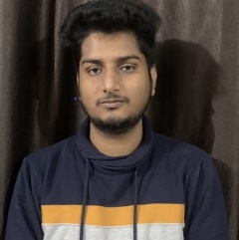
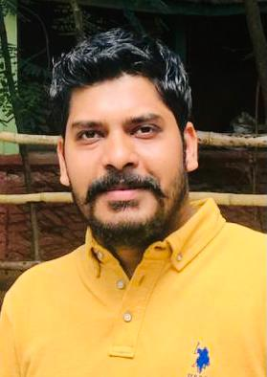


Our Team – Group 7
Ankit Paswan
Nishank
Work experience:
Industry:
Education:
Contact details:
5+ Years
Banking Sector
M. Com (2015-17)
B. Com (2009-12)
paswanankit001@gmail.com
+918866326609
Work experience:
Industry:
Education:
Contact details:
10 years
Sales & Marketing / Electronics
B.Sc (Hon) Hotel & Restaurant Management (2006-2010)
ipba20b6nishanks@iimidr.ac.in
+91-9871744400
Simran Zutshi
Akash Deepak
Work experience:
Industry:
Education:
Contact details:
2 years
Banking and finance sector
B. Com(hons) 2015-2018
simranzutshi4@gmail.com
+91 8585943244
Work experience:
Industry:
Education:
Contact details:
3+ years
Fraud Analytics
B.E - Electronics Engg. (2012-16)
ipba20b6akashd@iimidr.ac.in
+91-7569541575
Harsh Vardhan Giri
Kinshuk Chaturvedi
Work experience:
Industry:
Education:
Contact details:
8 years
Healthcare
M.Sc. Applied Quantitative Finance (2012)
B.Sc. (Hons.) Statistics (2010)
harshgiri12@gmail.com
+91-8860681299
Work experience:
Industry:
Education:
Contact details:
6+ years
Power/ Energy Sector
MBA - Energy Management (2015-17)
B.Tech - Electrical & Electronics Engg. (2008-12)
kinshuk.chaturvedi07@gmail.com
+91-9919888407
Eeram Nishat
Work experience:
Industry:
Education:
Contact details:
2+ Years
Industry: SAAS and cloud computing
B. Tech - Biomedical (2015-2019)
eeramnishaten@gmail.com
+91-9566186460

